Slide 1
ARTIFICIAL INTELLIGENCE IN FARMING
Roll Number | Student Name
20201CAI0001 | G Siva Sai Sathwik
20201CAI0002 | B Roshan Babu
20201CAI0049 | M Yaswanth
20201CAI0051 | R Bhargav
Under the Supervision of,
Mr. Mrutyunjaya M S
Associate Professor
School of Computer Science Engineering
Presidency University

Slide 2
INTRODUCTION
India, with a burgeoning population exceeding 1.25 billion, faces an escalating food security crisis, heightening the imperative for robust solutions in the agricultural sector. As a linchpin of the Indian economy, agriculture grapples with multifaceted challenges stemming from a population surge, erratic weather patterns, and volatile market conditions. The necessity for innovative approaches to sustain and enhance agricultural productivity becomes increasingly urgent in the face of these complex and interrelated issues.
This project delves into the heart of India's agricultural challenges, seeking to address the pressing concerns that hinder the sector's efficiency and resilience. With a focus on harnessing technology and artificial intelligence, the project aims to empower farmers by providing tailored recommendations for crop selection, optimal cultivation timing, and resource management. The overarching goal is not only to improve individual farming practices but to contribute to broader objectives of food security and sustainable agriculture. Through collaboration with experts, technological professionals, and government agencies, this initiative aspires to usher in a transformative era for Indian agriculture, leveraging cutting-edge solutions to navigate the intricacies of modern farming.

Slide 3
LITERATURE SURVEY
Rajak et al. 951-952 [1] Discuss crop prediction using several learners, including SVM as a classifier, Naive Bayes, Multilayer Perceptron (ANN), and Random Forest. Crop forecast characteristics include pH, depth, water holding capacity, drainage, and erosion.
The rule below demonstrates an example of the proposed recommendation system. If pH is mild alkaline depth is above 90 water holding capacity is LOW drainage is moderate and the erosion is LOW THEN PADDY
Dighe et al. 476-480 [2] We evaluated techniques such as CHAID, KNN, K-means, Decision Tree, Neural Network, Naïve Bayes, C4.5, LAD, IBK, and SVM to create rules for recommendation systems. To pick the most likely crops for plantation, numerous parameters such as soil pH, the month of cultivation, weather in the region, temperature, soil type, and so on were taken into account.
Mokarrama and Arefin [3] The following modules were discussed: location detection, data processing and storage, similar location detection, and recommendation creation. The final crop was calculated using the physiographic database, thermal zone database, crop growth period database, crop production rate database, and seasonal crop database.

Slide 4
LITERATURE SURVEY
Gandge and Sandhya [4] Discuss attribute selection, multiple linear regression, and decision trees with ID3, SVM, Neural Networks, C4.5, K-means, and KNN. The proposed system begins by selecting an agricultural field and then selecting a previously planted crop; it then takes user input and preprocesses it; in the backend, attribute selection is followed by a classification algorithm on data; and finally, the crop is recommended.
Mishra et al. [5]J48, LAD Tree, LWL, and IBK algorithms are utilized. The WEKA tool is used initially, and the LAD tree exhibited the lowest accuracy. However, trimming the tree can reduce errors, and IBK offers good results.
Wu et al. [6] IP102 is a large-scale dataset for insect pest identification that includes over 75,000 photos of 102 insects. In comparison to prior datasets, the IP102 accurately represents several aspects of insect pest dispersal in real-world settings. Meanwhile, they use the dataset to experiment with cutting-edge recognition systems. The results reveal that conventional handmade and deep feature approaches are insufficient for pest identification.

Slide 5
RESEARCH GAPS OF EXISTING METHODS
The literature analysis reveals that India's agricultural environment has made great achievements in harnessing technology, machine learning (ML), and artificial intelligence (AI) to solve critical areas of farming, such as crop recommendations, fertilizer consumption, and insect management. However, in this field of innovation, various research gaps and undiscovered territories emerge, highlighting prospects for further enhancement and refinement:
Integration of Comprehensive Data Sources: This analysis highlights studies on crop advice, fertilizer management, and pest detection. However, a significant gap exists in the integration and complete use of several data sources. Existing approaches frequently rely on small datasets or fail to incorporate multiple sources of information required for exact suggestions. It is still difficult to incorporate real-time, localized, and multidimensional data, such as soil parameters, weather patterns, historical crop yields, and insect profiles. A more comprehensive approach to data aggregation could improve the accuracy and relevance of recommendations.
Optimizing Recommendation Algorithms: Many machine-learning algorithms have been used for crop recommendation, fertilizer management, and pest identification. However, there is still room for improvement in accuracy and usability. The present procedures frequently rely on classic algorithms like SVM, Decision Trees, and Ensemble methods. However, a comparative investigation of the efficiency of these algorithms in the context of Indian agricultural settings is lacking. Furthermore, the implementation of cutting-edge techniques such as deep learning and neural networks for these purposes requires further investigation and validation in the Indian agricultural environment.
Tailored Recommendations for Agriculture: Given India's different agricultural environments, tailored recommendations are critical. Soil types vary in nutrient composition, ranging from fertile alluvial soils in the Indo-Gangetic plains to red and black soils on the Deccan Plateau, which influences agricultural development.

Slide 6
RESEARCH GAPS OF EXISTING METHODS
4.in Kerala's tropical environment. Diverse insect characteristics throughout states present various pest management issues. Addressing regional differences through fine-tuned recommendation systems is critical. Precise instruction tailored to area conditions empowers farmers, allowing them to make more informed decisions about improving sustainable agriculture methods.
5.Accessibility and Usability for Farmers: Improving the accessibility and usefulness of agricultural technological solutions is critical to their effective implementation by Indian farmers. The common absence of user-friendly interfaces in existing systems impedes their adoption, particularly among farmers with low technological skills. Simplifying the interface design and optimizing navigation are essential steps towards closing the gap. It is critical to provide intuitive and visually simple interfaces that transcend language boundaries and accommodate farmers with varied levels of literacy and technological proficiency. Furthermore, activities focused on farmer-centric design principles and usability testing suited to local contexts are required to guarantee that these solutions meet the unique needs and preferences of India's diverse farming community. By emphasizing user-centric design and ease of engagement, agricultural technology can become more inclusive, allowing all farmers to reap the benefits of these advances for increased production and sustainable agricultural practices.
6.Validation and Integration of Pest Identification Techniques: Validating pest detection systems under the various field circumstances seen throughout India is critical for their practical application.

Slide 7
PROPOSED METHODOLOGY
The process of creating an AI-driven application designed to support farmers in making well-informed decisions entails a methodical approach that includes problem analysis, identification of user needs, design of the program's architecture, and subsequent implementation of the application. The methodology utilized adheres to a well-defined framework to effectively address the varied requirements of the agricultural sector.
The methodology employed in this project centers on the resolution of issues encountered by farmers using integrating sophisticated technologies and employing data-driven decision-making. The method prioritizes user-centric design and development, aiming to create an intuitive application that addresses the specific needs of farmers. This is achieved by incorporating AI algorithms to provide personalized recommendations.
Ideology :The design procedure is a systematic approach used to develop and create a product system, or solution. It involves a series of steps.
A. Problem Analysis: An extensive examination was undertaken to analyze the various difficulties faced by farmers, encompassing volatile weather patterns, uncertainties in the market, and restricted availability of up-to-date information and professional guidance. The main pain points and gaps in present agricultural practices were identified to establish the basis for the functions of the application.
B. User Requirements: The research team actively engaged with farmers, agricultural specialists, and stakeholders tocomprehensively comprehend their specific needs, preferences, and limitations. It created an exhaustive inventory of user specifications, considering geographical disparities, crop-specific necessities, market dynamics, and issues related to accessibility.
C. Architectural Design: The application architecture was designed with careful consideration given to factors such as scalability, data integration, and user accessibility and developed a comprehensive architecture that incorporates multiple ayers, including data collecting, analysis, artificial intelligence algorithms, and a user-friendly interface.

Slide 8
PROPOSED METHODOLOGY
D. Application Development: The Agile technique was utilized to facilitate iterative development, enabling the integration of ongoing feedback from agricultural specialists. The selected programming languages, machine learning libraries, and development frameworks were employed to execute the implementation of data analysis and application interfaces. The primary objective is to develop a user-friendly interface that is intuitive and facilitates efficient navigation for farmers. This interface will be accessible through both web and mobile platforms, ensuring widespread availability.
E. Implementation of AI Algorithms: The AI algorithms were developed and deployed to facilitate data analysis, predictive modeling, and the development of personalized recommendations. The utilization of machine learning methodologies was employed to analyze a wide range of data sets, thereby offering customized recommendations and guidance to agricultural practitioners.
F. TestingandValidation:Aseriesofcomprehensivetestingphaseswereperformed to ascertain the functionality, dependability, and accuracy of the application. The application's recommendations were assessed for data accuracy and relevancy by comparing them to real-world events and expert opinions.
G. Phased Deployment and Iterative Improvement: The application was deployed in stages, considering user feedback, and implementing iterative enhancements to optimize performance and usability. Implemented a systematic process of ongoing surveillance and revisions to uphold the precision and pertinence of the data. The technique employed in this study is based on problem analysis, user-centric design, and iterative development. It provides a structured framework for the effective development and implementation of an AI-driven application that helps in predictive modeling. The fundamental goal of this application is to improve farmers' decision-making abilities in the field of agriculture by deploying the problem into three basic components, which are:
● Crop Recommendation
● Fertilizer Recommendation
● Pesticide Recommendation

Slide 9
OBJECTIVES
Agritence aims to help Indian farmers and reduce their hardship. Agritence's main goal is to provide a web-based solution that can assist farmers by recommending the type of crop to be grown that yields the best output, as well as providing the fertilizers required for the crop based on user-specific input, and even identifying pests and providing the necessary pesticide based on user input. "Agritence" has the following objectives:
Precision agriculture is a modern farming strategy that decreases crop selection errors and boosts productivity by collecting research data on soil kinds, characteristics, and crop yields.
To solve the issue, we propose a highly accurate and effective recommendation system for site-specific parameters based on an ensemble learning model and the majority voting technique.
To recommend organic fertilizer based on crop, N, P, and K values.
To identify the type of pest and suggest a specific pesticide that is accessible in India following ISO standards (ISO 9001, ISO 14001, ISO 17025).
To create a web application to accomplish the aforementioned goals with Flask.
Some of the other objectives include:

Slide 10
OBJECTIVES
1) Data Integration and Analysis:
a. Comprehensive Data Compilation: Aggregate data from meteorological agencies, agricultural research organizations, market reports, and soil health evaluations.
b. Integrated Repository: Combine disparate datasets to establish a comprehensive repository conducive to in-depth study.
c. AI Algorithm Implementation: Develop and deploy algorithms capable of effectively understanding data, enabling the generation of personalized suggestions.
2) Application Development:
a. User-Friendly Interface: Design and create an intuitive interface accessible through both mobile and web platforms.
b. Enhanced Accessibility: Ensure optimal usability for agricultural practitioners, facilitating effortless navigation and interpretation of insights and recommendations.
3) Personalized Recommendations: a. Individualized Guidance:
a. Provide farmers with personalized suggestions, considering their specific geographic location, historical crop data, current market trends, and up-to-date information.

Slide 11
SYSTEM DESIGN & IMPLEMENTATION
Tools and Technologies Used:
The list of all the tools and technologies used while implementing the project “Agritence” are listed below:
numpy - working with arrays.
pandas - working with CSV files.
flask- app routing and web application.
pickle- saving Machine Learning model
pymongo- databases for Agritence users and feedback
Neural networks like Keras, TensorFlow, CNN - It is used for the classification and training of deep learning models.
PyCharm - Python offlie coding
OS - windows, linux
Matplotlib.pyplot - plotting graphs for training and testing accuracy and losses
h5 - The storage unit of a Deep Learning mode

Slide 12
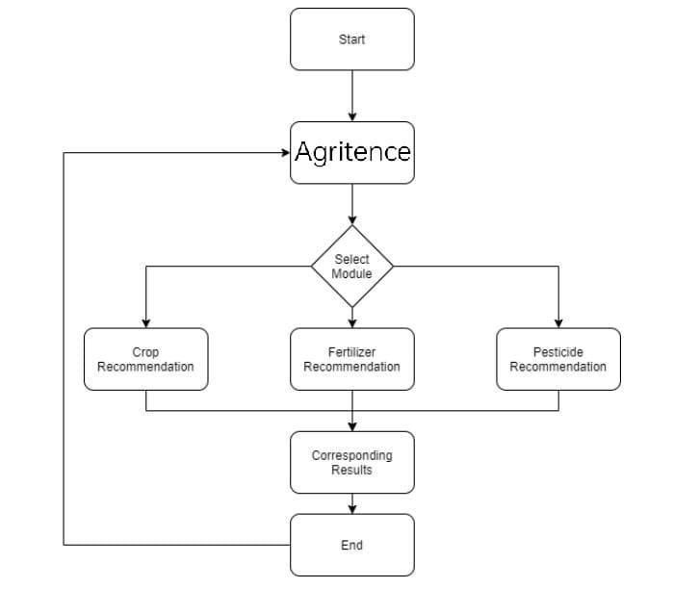
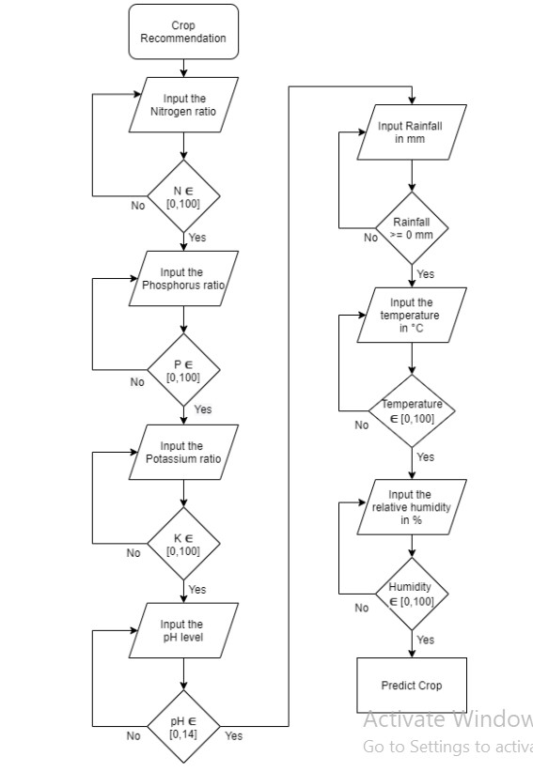
SYSTEM DESIGN & IMPLEMENTATION

Slide 13
SYSTEM DESIGN & IMPLEMENTATION
Implementation Steps:
The steps to implement “Agritence” are divided into several tasks and sub-tasks that effectively complete the project as mentioned below:
1. Research on project
a. Studying Research Papers
b. Requirement Analysis
c. Study on crops, fertilizers, pests, pesticides
2. Project Documentation
a. Analysis Modeling
b. Design Modeling
3. Crop Recommendation
a. Data Acquisition
b. Values Input
c. ML model using ensemble method and creating. pkl file
d. Using .pkl file for crop recommendation

Slide 14
4. Fertilizer Recommendation
a. Data Acquisition
b. Values Input
c. Difference between desired and actual
d. Dictionary-based solution
5. Pesticide Recommendation
a. Data Acquisition
b. Data Cleaning and Data Augmentation
c. DL model training
d. Pest Identification and corresponding Pesticide Recommendation
6. End-to-End Deployment
a. Flask Coding
b. Front End Design
c. Integrating all three modules

Slide 15
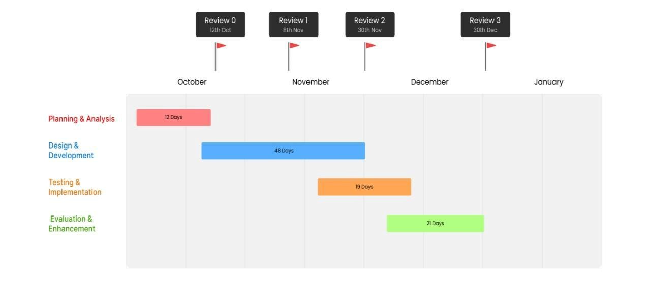
TIMELINE FOR EXECUTION OF PROJECT

Slide 16
OUTCOMES:
The ongoing evolution of the AI-powered application designed to support agriculture anticipates achieving impactful results, contributing to advancements in farming techniques and fostering well-informed decision-making for farmers. The expected outcomes encompass various dimensions, including functionality, accessibility, and the overall impact on agricultural productivity. A. Tailored Advice:
● The application aims to provide personalized and real-time advice to farmers regarding optimal crop choices, production timing, and resource management.
● Recommendations will be tailored based on individual geographic areas, prevailing market trends, and specific crop requirements. B. Enhanced Decision-Making:
● Empowering farmers with precise, evidence-based information to facilitate well-informed decision-making.
● Reducing potential risks associated with uncertain weather patterns, market volatility, and resource availability.
C. Increased Agricultural Productivity:
● The application's guidance is anticipated to lead to heightened agricultural productivity, translating to enhanced crop yields, minimize losses, and optimized
resource utilization.
D. Improved Accessibility:
● Key emphasis on a user-friendly design accessible through both mobile and online platforms.
● Addressing the accessibility divide by reaching farmers in diverse regions, irrespective of language proficiency or technological competence. E. Promotion of Sustainable Practices:

Slide 17
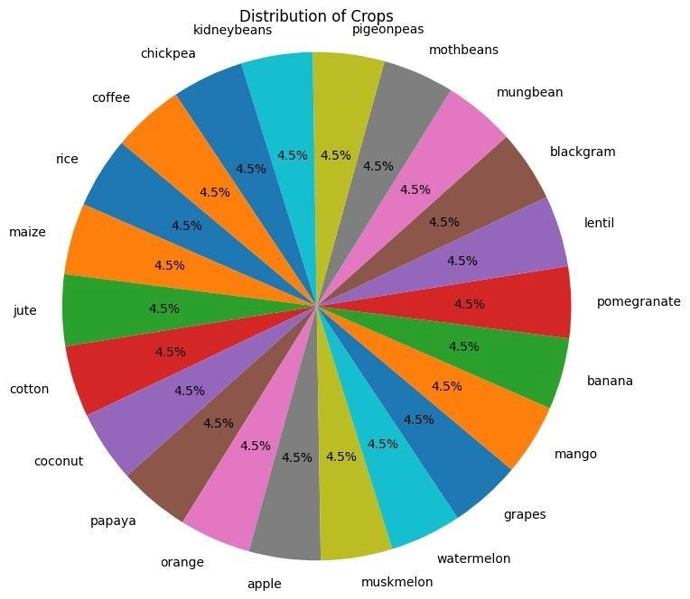
RESULTS AND DISCUSSIONS
The continuous evolution of AI-powered agricultural applications has led to significant changes in the field, showcasing its potential to revolutionize farming practices and contribute to the overall resilience and productivity of the agricultural sector.
Agritence is an agriculture-based project, hence data is critical in anticipating the exact outcome. In addition, data should be dispersed equitably throughout each crop to ensure that the model is trained equally for all crop labels. The picture below in Figure 4.1 depicts the data distribution of 22 crop kinds in similar proportions, which plays an important role in improving the accuracy of the predictive machine-learning model by training the model evenly for all crop labels.

Slide 18
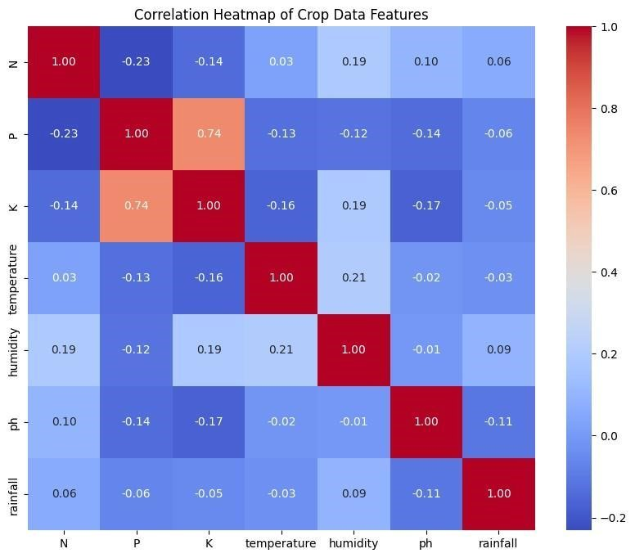
RESULTS AND DISCUSSIONS
A correlation heatmap is a visual representation of the correlation matrix in Figure 4.2, which shows the correlation coefficients between many variables. It is commonly used in data analysis and statistics to quickly identify patterns and relationships between variables in a dataset. It also helps in feature selection and is often used as a diagnostic tool to identify potential issues such as outliers or errors in the dataset. The below figure shows the correlation features of the crop data features.

Slide 19
CONCLUSION:
Finally, this project represents a tremendous advancement in harnessing technology to address crucial difficulties in Indian agriculture.
The program, which provides individualized advice for crop management, fertilization, and pest control, is a transformative tool that empowers farmers and promotes sustainable practices. However, this is only the start of a path toward agricultural innovation.
The future scope is constantly refined and expanded. It is critical to refine the application's algorithms in response to ongoing feedback, integrate more robust data sources, and react to changing area agricultural dynamics. Furthermore, efforts to improve accessibility among varied farming groups, as well as the incorporation of innovative technologies like IoT and blockchain, have the potential to unlock new levels of efficiency and transparency in agriculture.
Exploring collaborations with government agencies and agricultural research institutions could increase the application's influence and scope. Furthermore, expanding the application's reach across borders to help farmers in similar agro-climatic zones around the world could increase its scope and significance.
In essence, while this project establishes a solid basis, the future beckons with prospects for deeper integration, greater accessibility, and continual innovation in agricultural technology, offering a brighter, more sustainable future for Indian agriculture.

Slide 20
REFERENCES
[1] Rajak, Rohit Kumar, et al. “Crop Recommendation System to Maximize Crop Yield using Machine Learning Technique.” International Research Journal of Engineering and
Technology (IRJET), vol. 04, no. 12, 2017, pp. 951-952. IRJET, https://www.irjet.net/archives/V4/i12/IRJET-V4I12179.pdf.
[2] Dighe, Deepti, et al. “Crop Recommendation System for Precision Agriculture.” IRJET, vol. 05, no. 11, 2018, pp. 476-480. IRJET, https://www.irjet.net/archives/V5/i11/IRJET-V5I1190.pdf.
[3] Mokarrama, Miftahul Jannat, and Mohammad Shamsul Arefin. “RSF: A Recommendation System for Farmers.” Region 10 Humanitarian Technology Conference, vol. 2, no. 17, 2017,
https://www.researchgate.net/publication/323203384_RSF_A_recommendation_system_for _far mers.
[4] Gandge, Yogesh, and Sandhya. “A study on various data mining techniques for crop yield prediction.” IEEE Xplore, 2017. IEEE Xplore, https://ieeexplore.ieee.org/document/8284541.
[5] Mishra, Shruti, et al. Use of data mining in crop yield prediction. 2018. ResearchGate, https://www.researchgate.net/publication/326073480_Use_of_data_mining_in_crop_yield_p rediction.
[6] Wu, Xiaoping, et al. A Large-Scale Benchmark Dataset for Insect Pest Recognition.
2019. IEEE Xplore,
https://openaccess.thecvf.com/content_CVPR_2019/papers/Wu_IP102_A_Large-Scale_Ben chm ark_Dataset_for_Insect_Pest_Recognition_CVPR_2019_paper.pdf.
[7] Kasinathan, Thenmozhi, et al. Insect classification and detection in field crops using modern machine learning techniques. 2020. Science Direct, https://www.sciencedirect.com/science/article/pii/S2214317320302067.

Slide 21
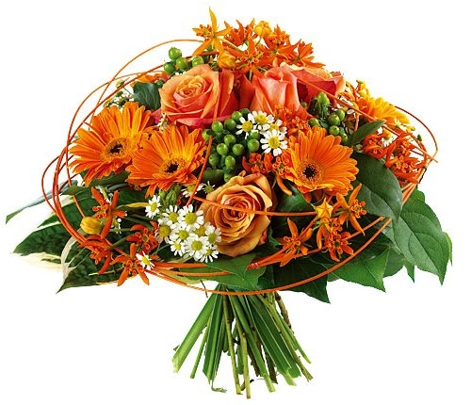
Thank You

